Slide 1

CHESS: Systematic Concurrency Testing
Elvira Ariaputra
CB13125
11th March 2014

Slide 2
CHESS
Model checking tool
A software model checker for finding errors/heisenbugs in multithreaded software by systematic exploration of threads schedules.
Locates error, provides fully repeatable execution of program leading to the error

Slide 3
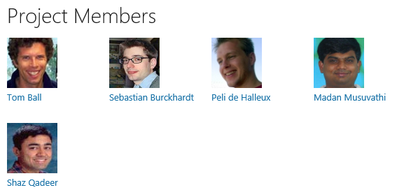
Microsoft Research Project
2007

Slide 4
why this is called
CHESS
because they’re making many moves ahead to see what’s going to happen and then make the right move for the future.

Slide 5
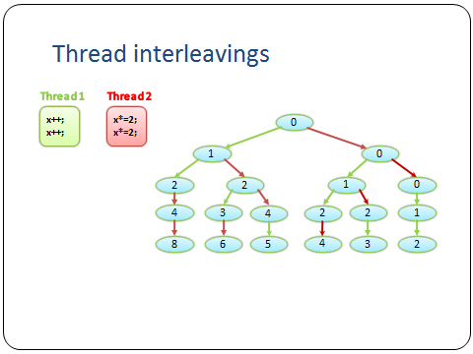
Testing concurrent programs is HARD
Rare thread interleavings expose bugs

Slide 6
CHESS in a nutshell
ConcurrentProgram
Replace the OS scheduler with a demonic scheduler
Systematically explore all scheduling choices
Win32 API
Kernel
Scheduler
Demonic
Scheduler

Slide 7
Iterative context bounding prioritizes among the schedules that if the ones with the errors generates, those schedules that are more likely to yield bugs.

Slide 8
Sample/ Implemetation
Visual Studio
CHESS discovered a bug in PLINQ (Parallel LINQ) which caused by improper use of LiteEvents, a concurrency primitive implemented in the library.
Singularity operating system was successfully booted under the control of CHESS.

